Slide 1
Chapter 1: Information System in Global Business Today
Krishna Kumar Jha

Slide 2
Learning Objectives
Definition of Information System
Definition of Management Information System
Role of Information system in business Today
Globalization Challenges and Opportunities
Strategic Business Objectives of Information Systems
Business perspective of Information System

Slide 4
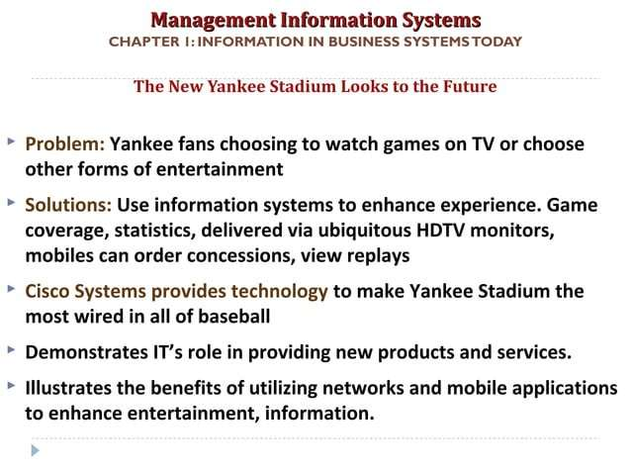

Slide 5
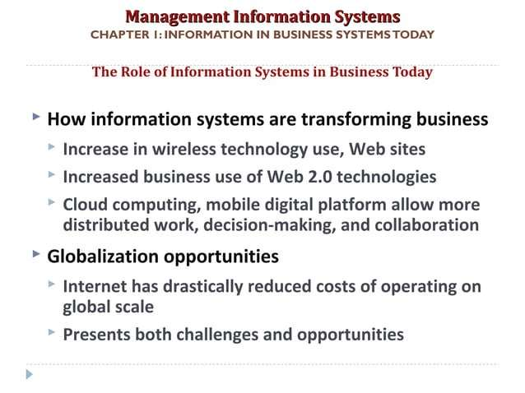

Slide 6
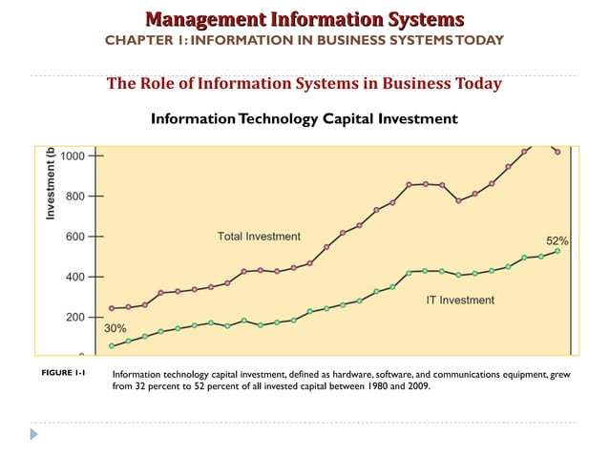
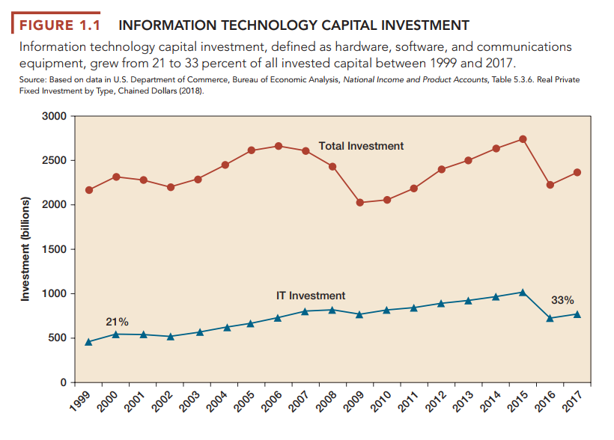

Slide 7
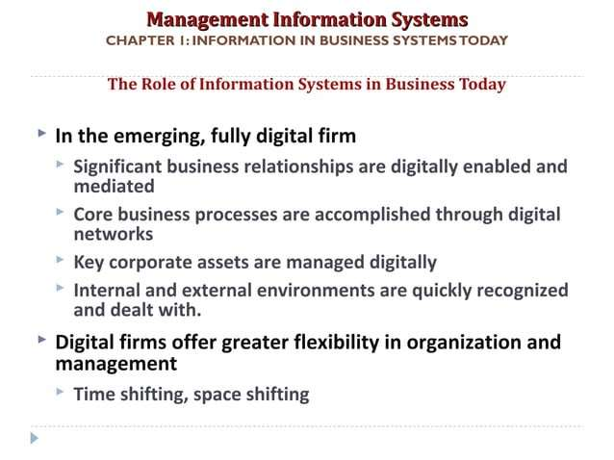

Slide 8
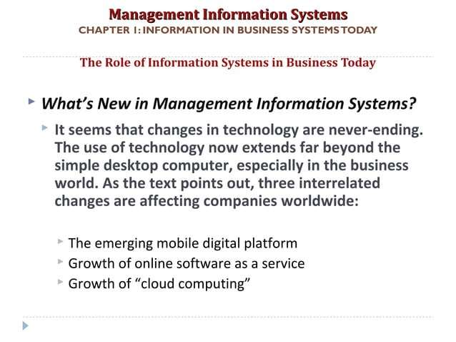

Slide 9
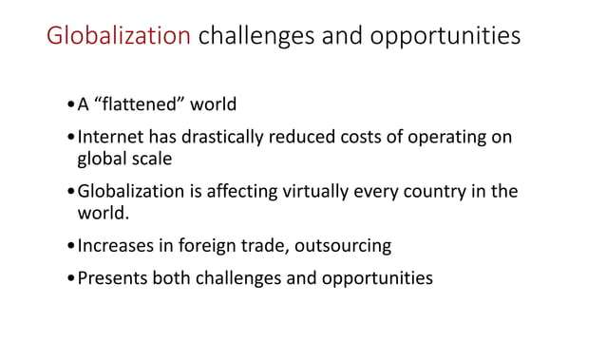

Slide 10
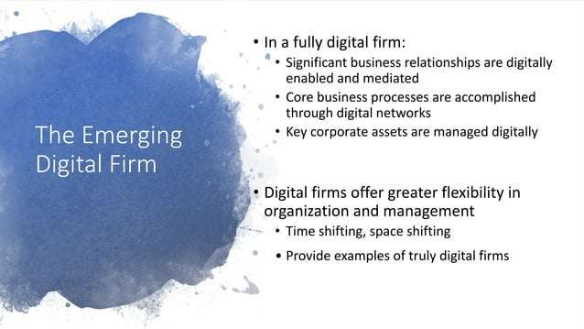

Slide 11
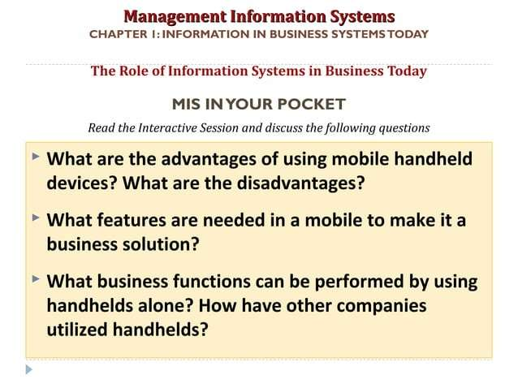

Slide 12
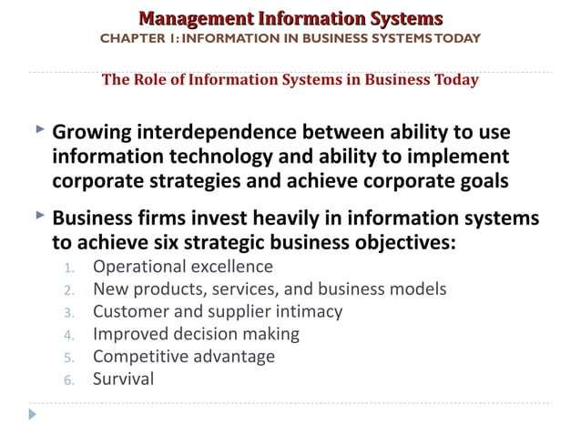

Slide 13
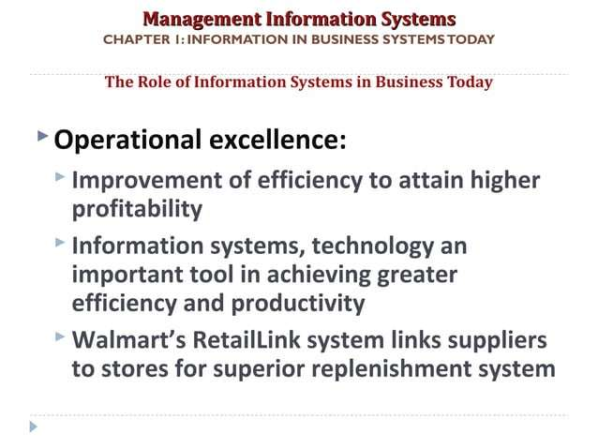

Slide 14
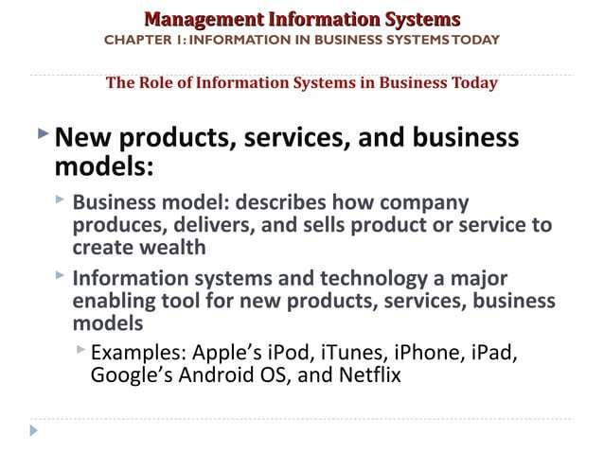

Slide 15
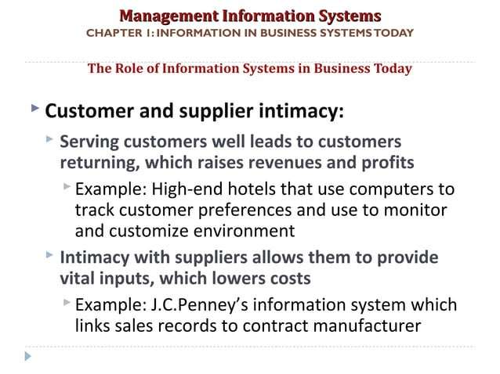

Slide 16
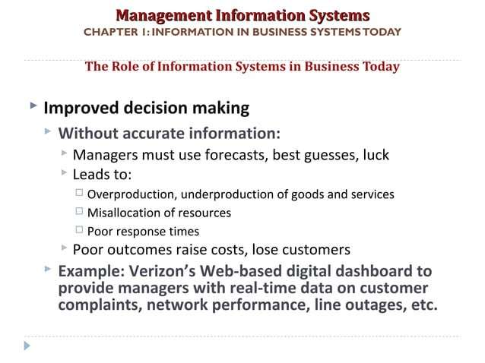

Slide 17
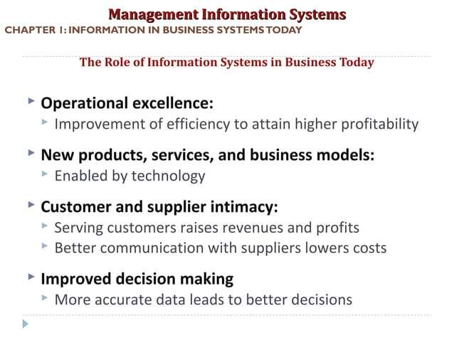

Slide 18
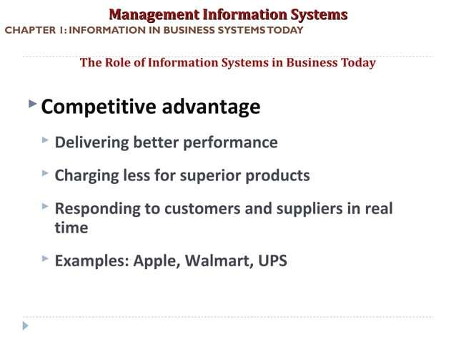

Slide 19
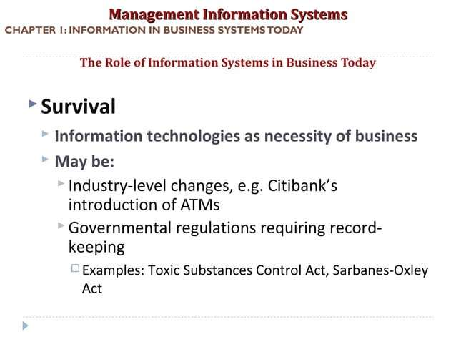

Slide 20
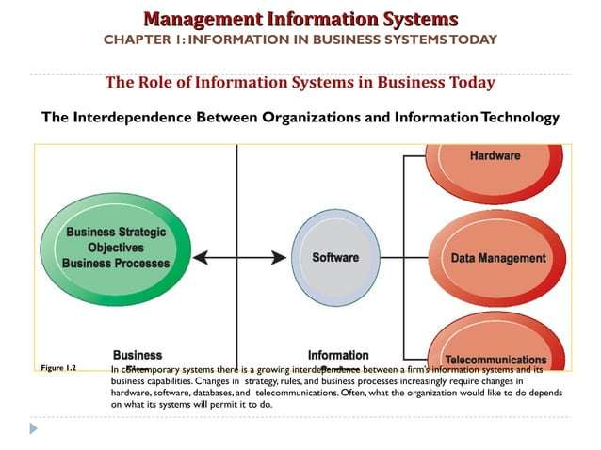

Slide 21
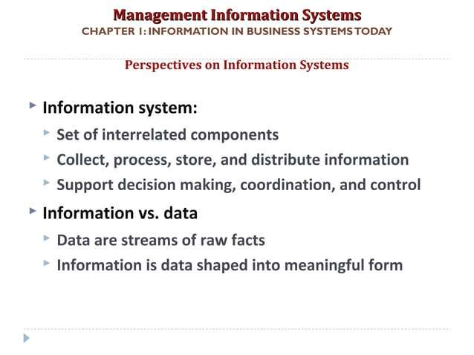

Slide 22
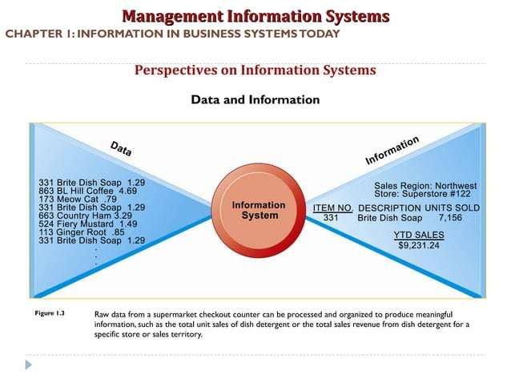

Slide 23
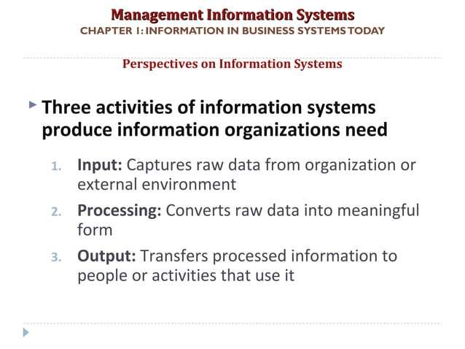

Slide 24
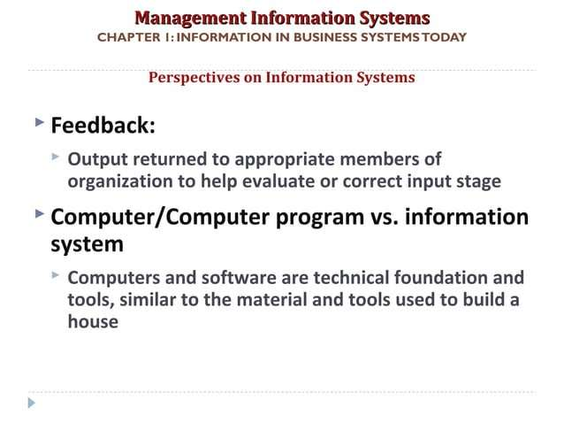

Slide 25
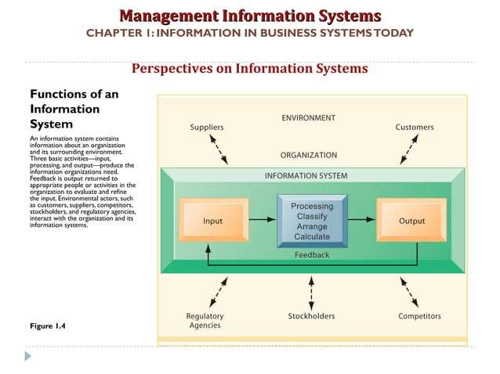

Slide 26
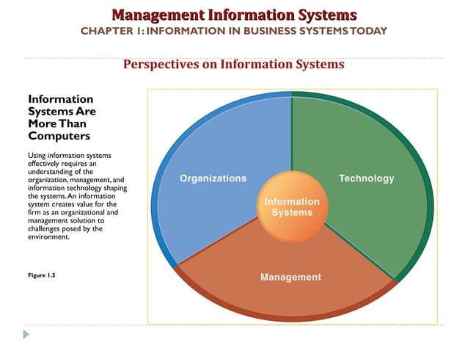

Slide 27
To fully understand information systems, you must understand the broader organization, management, and information technology dimensions of systems (see Figure above) and their power to provide solutions to challenges and problems in the business environment.
We refer to this broader understanding of information systems, which encompasses an understanding of the management and organizational dimensions of systems as well as the technical dimensions of systems, as information systems literacy. Computer literacy, in contrast, focuses primarily on knowledge of information technology.
The field of management information systems (MIS) tries to achieve this broader information systems literacy. MIS deals with behavioral issues as well as technical issues surrounding the development, use, and impact of information systems used by managers and employees in the firm. Let’s examine each of the dimensions of information systems—organizations, management, and information technology.

Slide 28
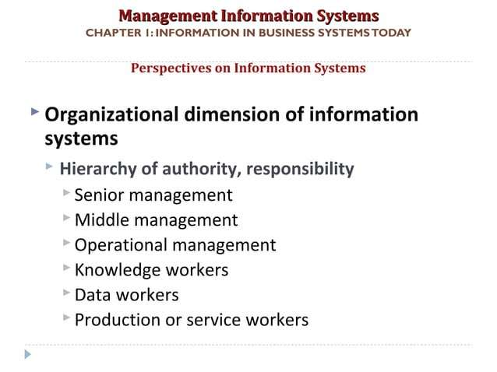

Slide 29
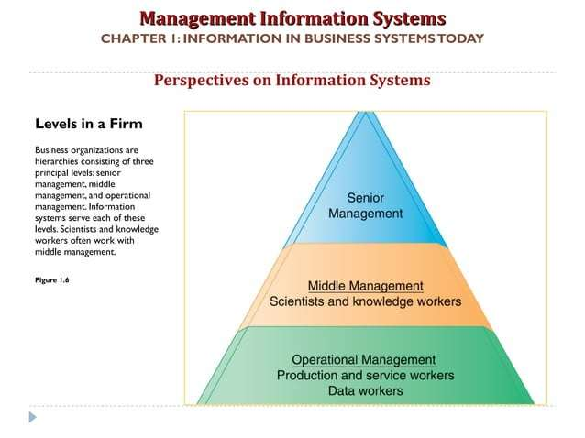

Slide 30
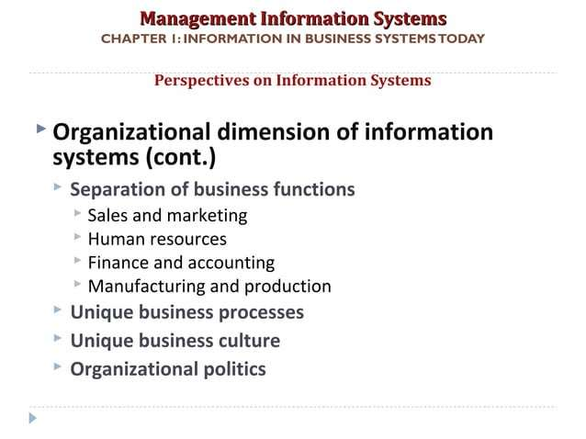

Slide 31
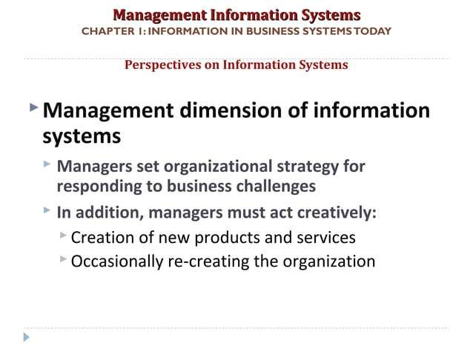

Slide 32
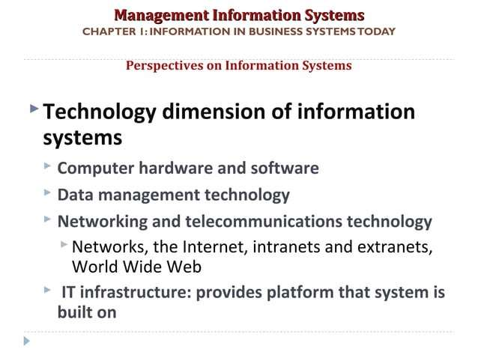

Slide 33
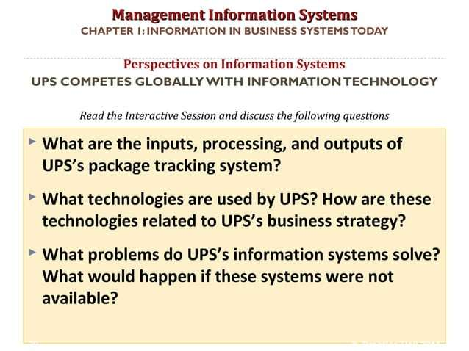

Slide 34
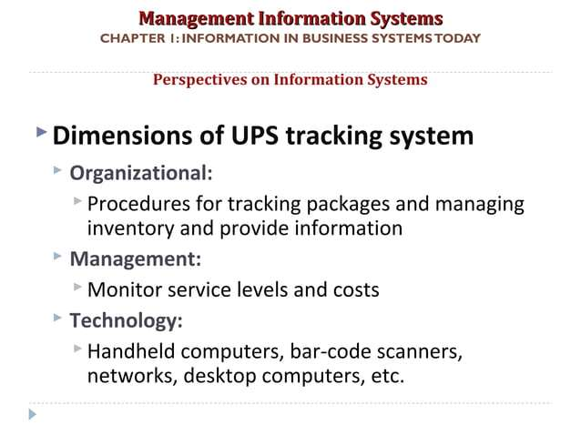

Slide 35
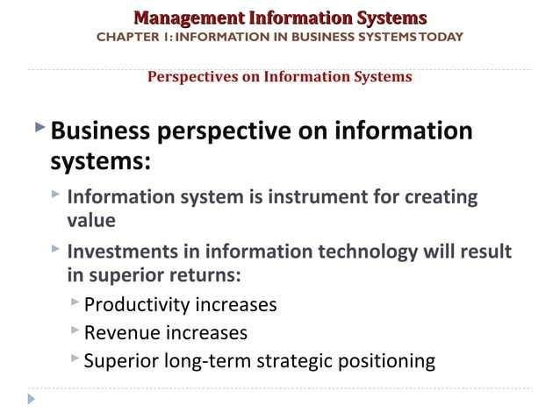

Slide 36
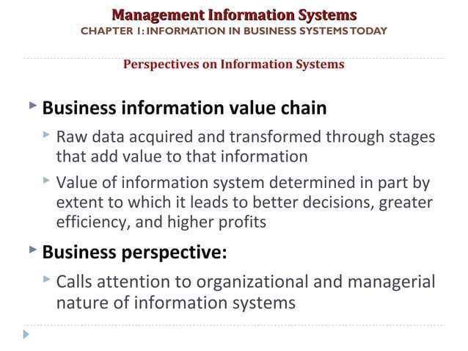

Slide 37
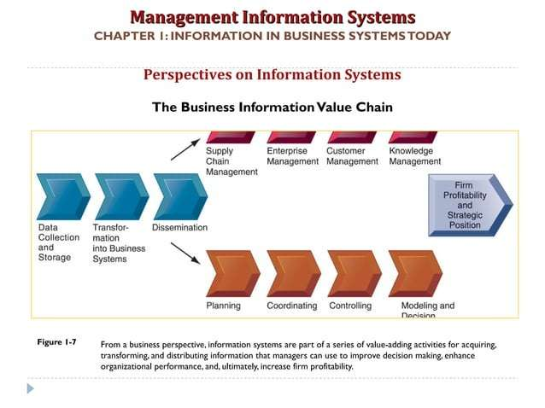

Slide 38
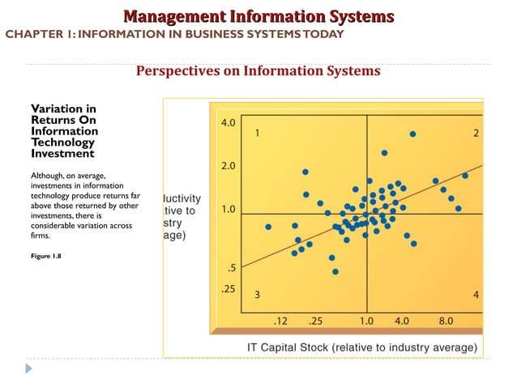

Slide 39
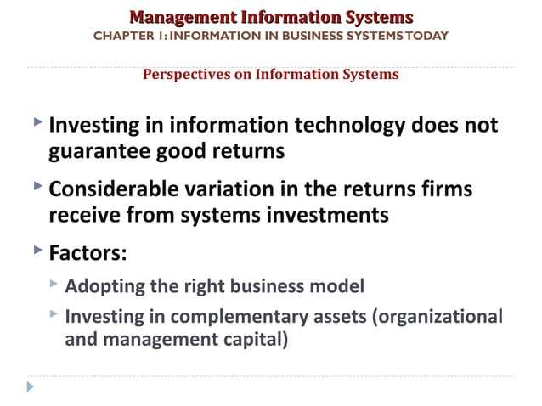

Slide 40
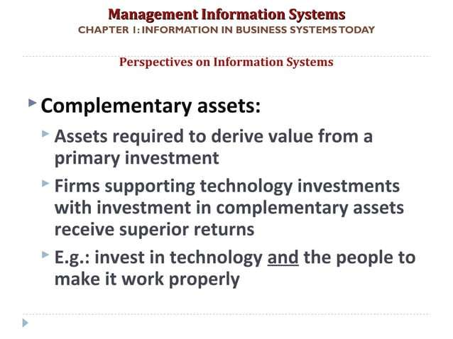

Slide 41
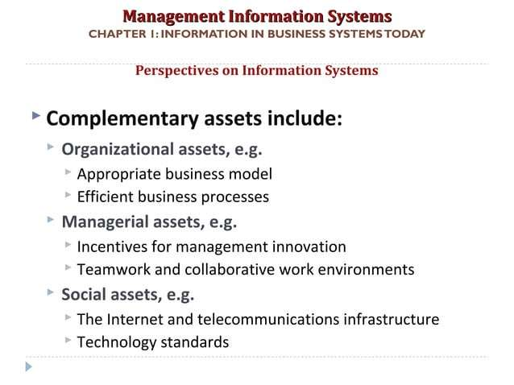

Slide 42
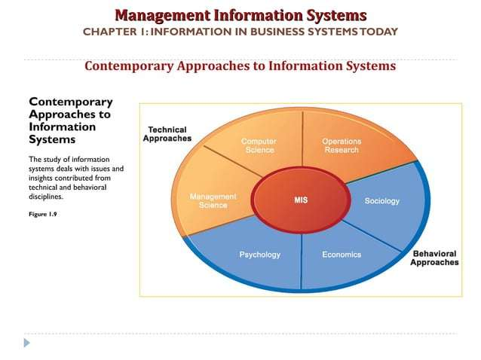

Slide 43
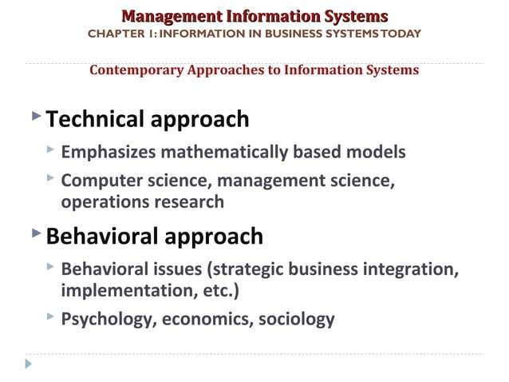

Slide 44
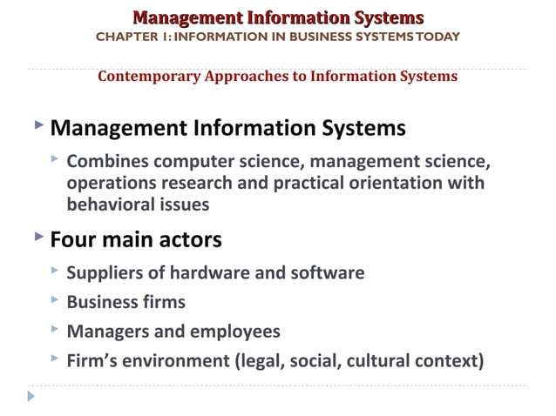

Slide 45
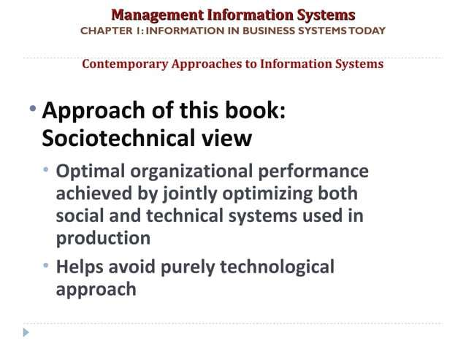

Slide 46
